Slide 1

English Learner Students in WCSD
Joshua B. Padilla
Jan Hall
Office of Accountability

Slide 2

Session Goals
1. Review data regarding the EL student population in WCSD.
2. Learn about how grade in which students exit EL services is related to students outcomes.
3. Discuss how the data informs our perceptions of EL students capabilities.
Notes:
Session goals will depend on focus of presentation

Slide 3
ELs in WCSD?
Currently this year (2016-17 school year):
  16% of WCSD students are classified as EL
  90% speak Spanish, 10% speak other Languages
  71% were born in Washoe County
  88% were born in the U.S.

Slide 4
The proportion of EL students in WCSD has increased over the last 10 years
WCSD n= 8,126 8,591 9,107 10,537 10,505 11,156 11,299 10,831 10,452 10,259 10,028 10,114

Slide 5
EL Population is Always Flowing
EL students vary when they enter and exit services.
The federal govt., state govt., and WCSD operationalize EL students as only those who are currently receiving services.
  This creates a caveat when reporting data on EL students.

Slide 6
Data Reporting of EL Student Graduation Rates

Slide 7
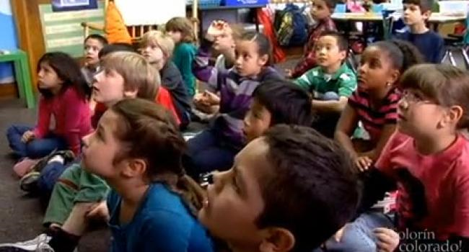
Reporting on current students receiving EL services only provides part of the picture.
We are often asked about the students who exit.
  How do students who exit out of services do in the WCSD?

Slide 8

We looked at the past three graduation cohorts to get some perspective
Gathered and analyzed data to provide information.
- Data obtained from the graduation data files.
Graduation Cohort | Total Students in Cohort | Total EL Students Ever
2014 | 4,766 | 1309
2015 | 4,624 | 1436
2016 | 4,711 | 1444
 | 14,101 | 4,189
30% of the students in these three cohorts were at one time classified as EL students.

Slide 9
Of the students who ever received EL services (N=4,189), continuous enrollment was a major factor of student success.
EL Student Cohort Outcomes
 | Students Not Continuously Enrolled |  | Students Continuously Enrolled
 | n | % | n | %
Graduate | 872 | 53% | 1535 | 73%
Nongrad | 787 | 47% | 572 | 27%
Transferred Out of the District | 423 |  | 0
Total | 2082 |  | 2107

Slide 10


We conducted an analysis on the 2,107 EL students who are continuously enrolled since Kindergarten
For students who have been in the WCSD since Kindergarten, how does time of exit relate to their educational success?
  ELs who were with us from K-12.
  Success will be determined by graduation.

Slide 11

Talking Points
As we follow these students who were continuously enrolled, and stayed with us throughout their education, quickly think about what you expect to see.

Slide 12
So when does this group of kids exit?
Point-biserial correlation coefficient, rpb = -494, which is statistically significant (p= .023)

Slide 15


Talking Points
What do we see?
How does this data relate to our earlier thoughts?
Are there any surprises?

Slide 16
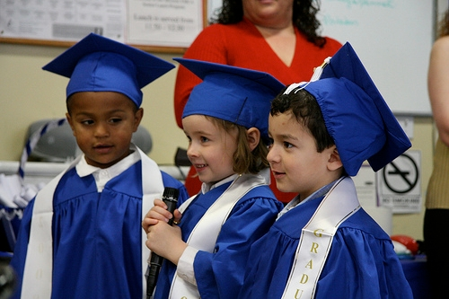

What Else Does the Graduation Data Tell Us?
Cohort Outcomes by EL Exit Group
  Advanced and Honors Diploma
  Drop Out/Vanished Students
Relationship between IEP and exiting EL services

Slide 17
Cohort Outcomes by EL Exit Category

Slide 18

Approximately 80% of EL students who were continuously enrolled from Kindergarten and never exited services also had an Individualized Education Plan.
- Of the overall EL sample who had IEPs, 49% (n=140 of 285) never exited.
 | Total EL Exits | Number of Students with IEP | Percent of ELs Exiting with IEP
Kindergarten | 29 | -- | --
First | 46 | -- | --
Second | 180 | -- | --
Third | 516 | -- | --
Fourth | 212 | -- | --
Fifth | 270 | -- | --
Sixth | 202 | -- | --
Seventh | 210 | 30 | 14%
Eighth | 152 | 35 | 23%
Ninth | 54 | 19 | 35%
Tenth | 37 | 17 | 46%
Eleventh | 13 | 6 | 46%
Twelfth | 10 | 5 | 50%
Did not exit | 176 | 140 | 80%

Slide 19
Talking Points
What do we see?
How does this data relate to our earlier thoughts?
Are there any surprises?

Slide 20

Conclusion
Thank you for your time and discussion ☺

